Slide 1


SAP UI5 & FIORI with OData TRAINING
Anubhav Oberoy & Nishan Nainsukha
Day – 16

Slide 2

Agenda – Day 16
Implementing the Order header and Order Item Sets
Association
Association (1:1)
Association (1:n)
Image Processing

Slide 3
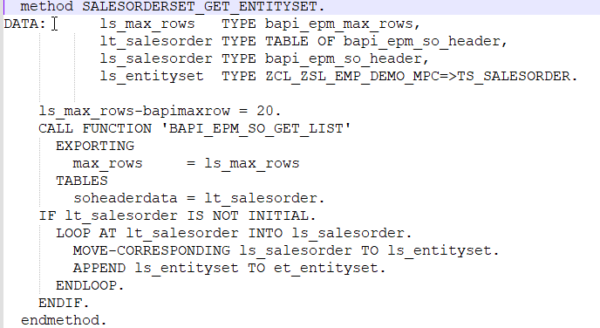
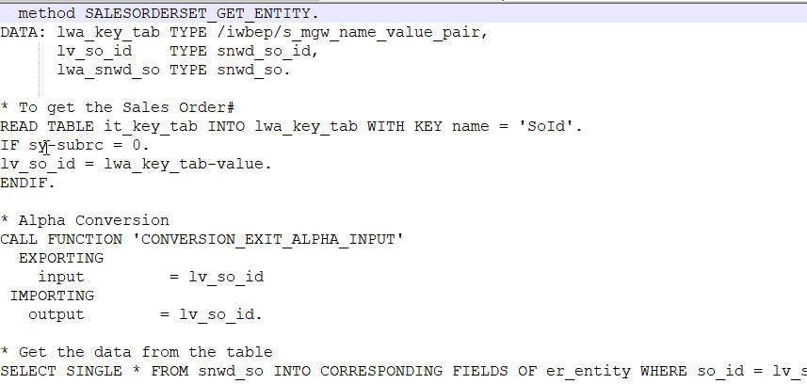
Implementing the Order header and Order Item Sets
Create the new entity set with name –
SalesOrder
OrderItem
Implement the GetEntity and GetEntitySet for both entity set

Slide 4
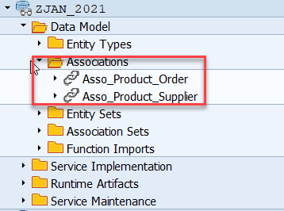
Association
Associations are relationship Between entities.
At database level we have foreign key relationship and same is reflected at odata level.
Once a association is created only then we can create navigation property.
Product
Supplier
1 relation 1
nav
Sales Order Header
Sales Order Items
1 relation n
nav

Slide 5
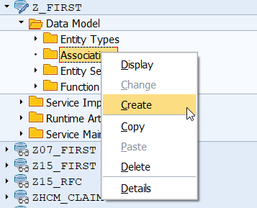
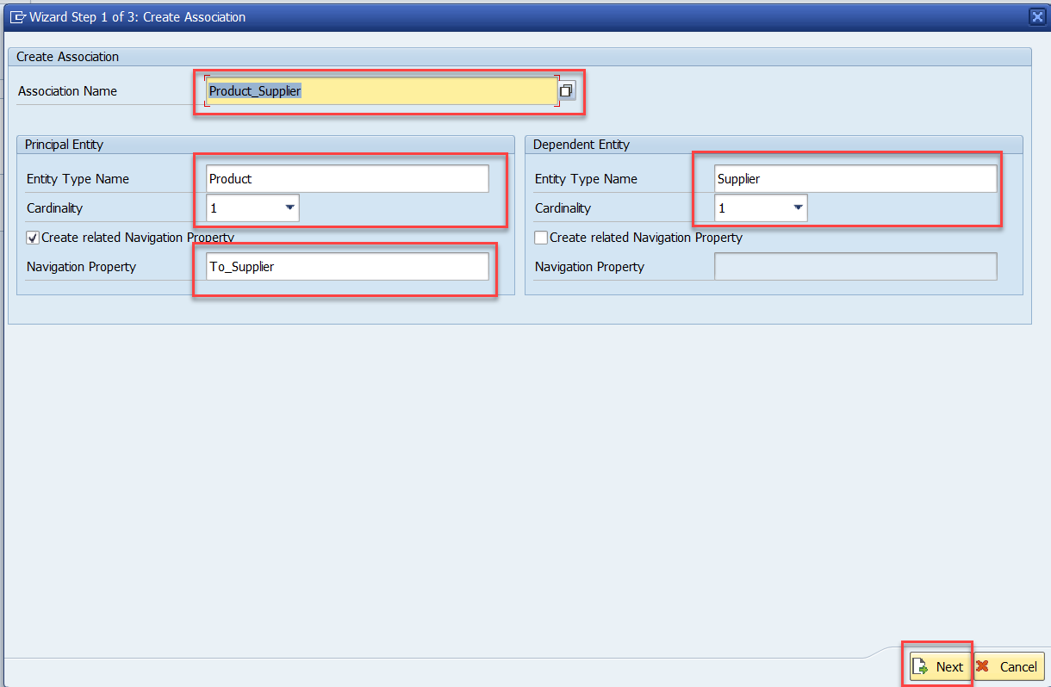
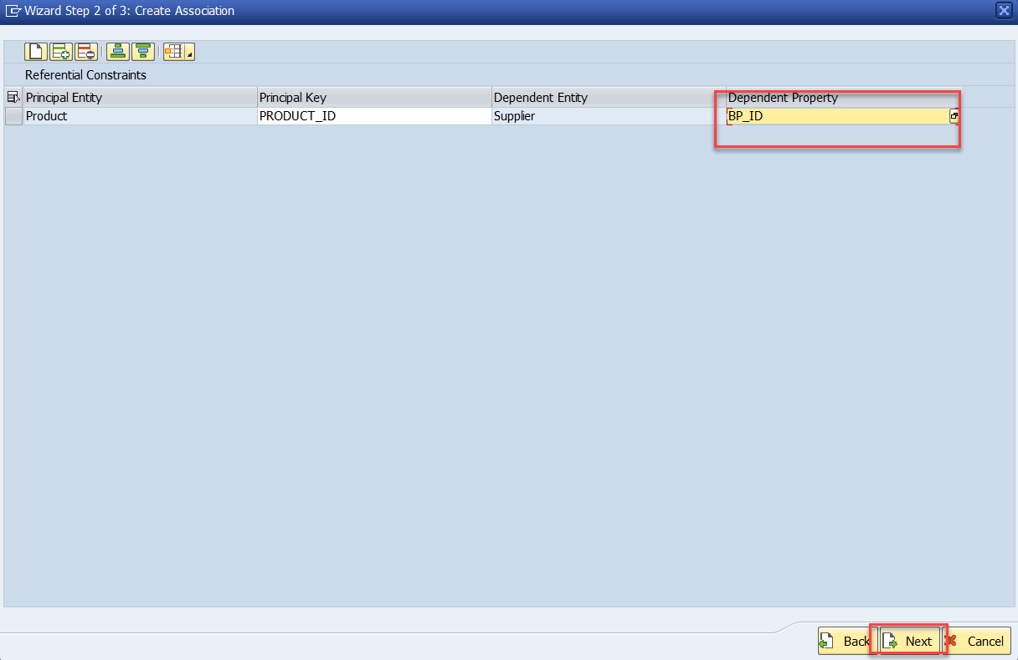
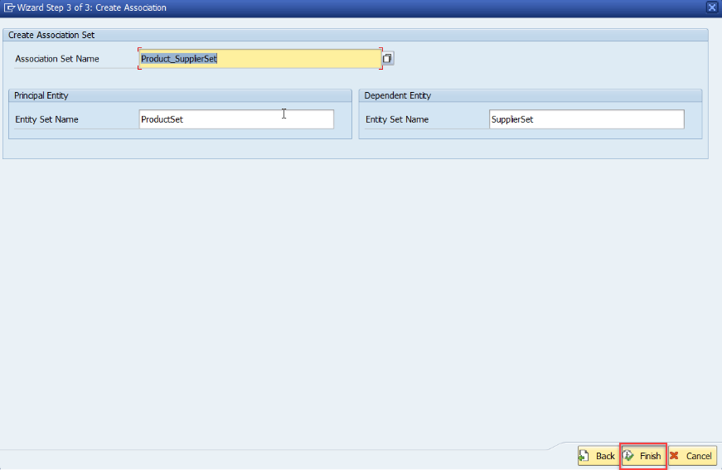
Association (1:1)
Step:1 Right Click on Association and click on create

Slide 6
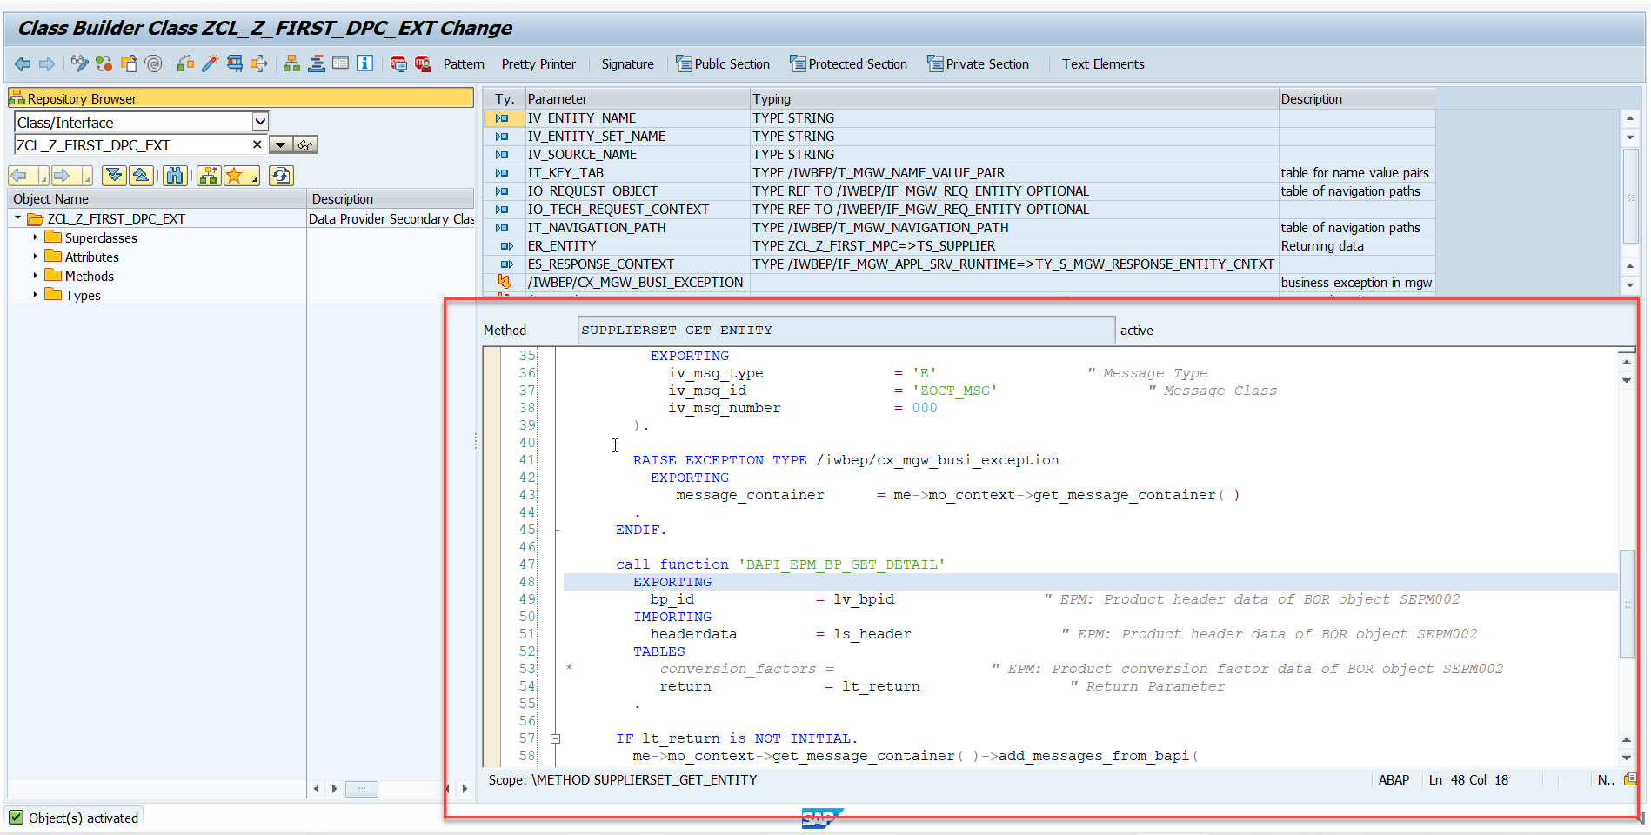
Association (1:1)
Step2: Go to DPC extension and redefine the method for supplierSet GetEntity

Slide 7
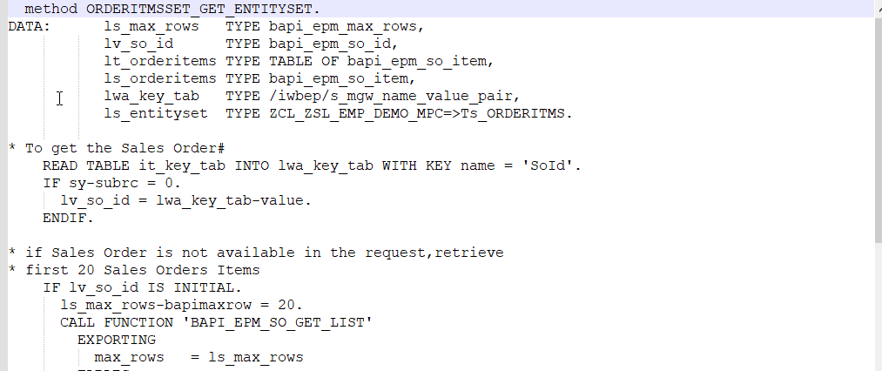
Association (1:n)
Step1: Right Click on Association and click on create and give Cardinality 1:n
Step2: Go to DPC extension and redefine the method for ORDERITMSSET_GET_ENTITYSET.

Slide 8

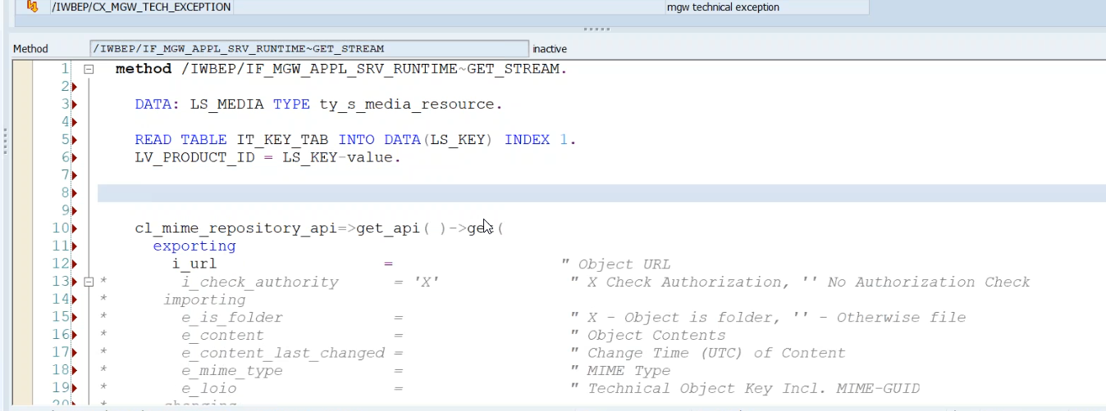
Image Processing
In ABAP all images are store in MIME Repository.
to see MIME Repository - go to se80 > utilities > settings > MIME Repository
to add Image in Odata
Step1: Go to service > entity Type > Product > select the media check box
Step2: Now add two new property to Product Set
- Product_pic_url
- MIME_TYPE
Step3: Go To MPC Extension Class and redefine the DEFINE method(for code ClickHere)
Step4: Go to DPC Extension class and redefine the Method Get_Stream (for code ClickHere)

Slide 9

End of Day 16

Slide 10

Questions

Slide 11

Anubhav Oberoy

Slide 12


We’re committed to empower you to be
Most Desirable Resource
through powerful training solutions.
We build the workforce of the future.
250+
Corporate Clients
30,000+
Learners Trained
25000+
Learners Placed
FREE WEBINARS
Sign up for free webinars with industry experts every fortnight!
Enroll Now!
Contact us today!
https://anubhavtrainings.com/

Slide 13




More from AnubhavTrainings.com

